Slide 1
AI-Powered Nail Scan for Anemia Risk Detection
TEAM: HemoScan

Slide 2

Basic Details of The Teams and problem statement
Project Name: Hemo_Scan
“AI-powered nail scan for anemia risk detection”
Team name :HemoScan
Team Members name :
Fatima Ahsan
Mariam Saad
Aiman Rasheed
Iqra shahzad

Slide 3
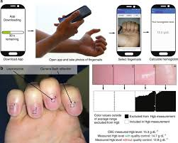
Inspiration
•Anemia is one of the most common health conditions worldwide.
• Many people don’t know they have it – it often goes undiagnosed.
• We wanted to build an easy, accessible, and non-invasive way to help people check anemia risk.

Slide 4


1. What It Does
Takes a simple photo of fingernails.
AI model predicts:
Class: Anemic / Borderline / Normal
Hemoglobin estimate (Hb g/dL)
Risk level (High, Medium, Low)
Shows Grad-CAM heatmaps to explain what the model focused on.

Slide 5
How We Built It
Dataset of fingernail images with Hb values.
Preprocessing and augmentation for better generalization.
Model: MobileNetV3 with two outputs:
Classification head (Anemia classes).
Regression head (Hb value).
Trained on Google Colab (GPU).

Slide 6
Challenges
Small dataset → hard to get high accuracy.
Class imbalance (more samples of some classes).

Slide 7
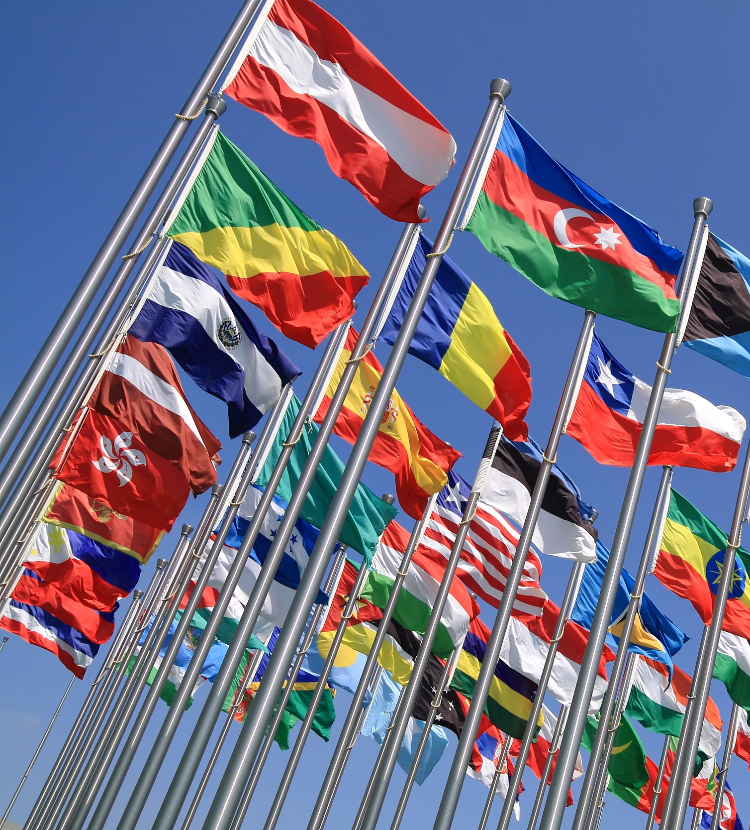
Accomplishments
• Built a working prototype that detects anemia risk from nails.
• Achieved reasonable accuracy with a small dataset.
• Visual explanations using Grad-CAM.
• Designed with accessibility in mind.

Slide 8
What We Learned
•Data quality and balance are critical in medical AI.
• Combining classification + regression helps give richer predictions.
• Explainable AI (Grad-CAM) builds trust in health-related models.

Slide 9
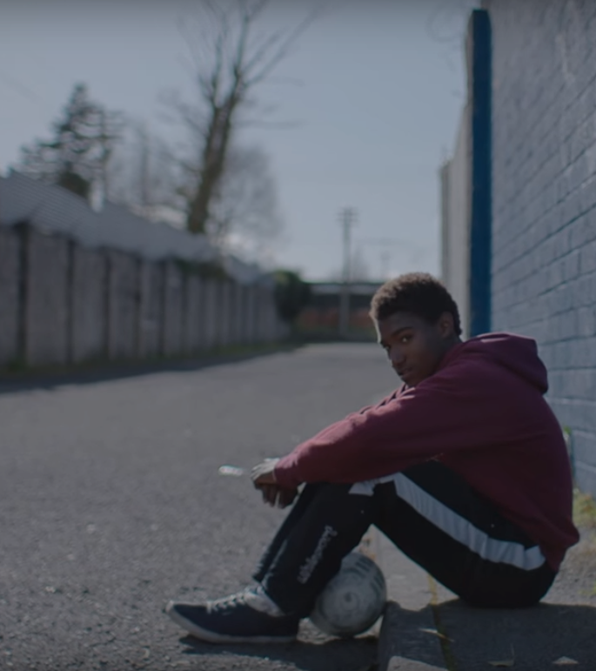
• Collect a larger, more diverse dataset.
• Improve accuracy with better training strategies.
• Build a mobile/web app for real-time scanning.
• Collaborate with healthcare experts for validation.
What’s Next

Slide 10

Built With
• Python
• PyTorch & Torchvision
• OpenCV
• Pandas & NumPy
• Matplotlib & Seaborn
• PIL (Pillow)
• Google Colab

Slide 11
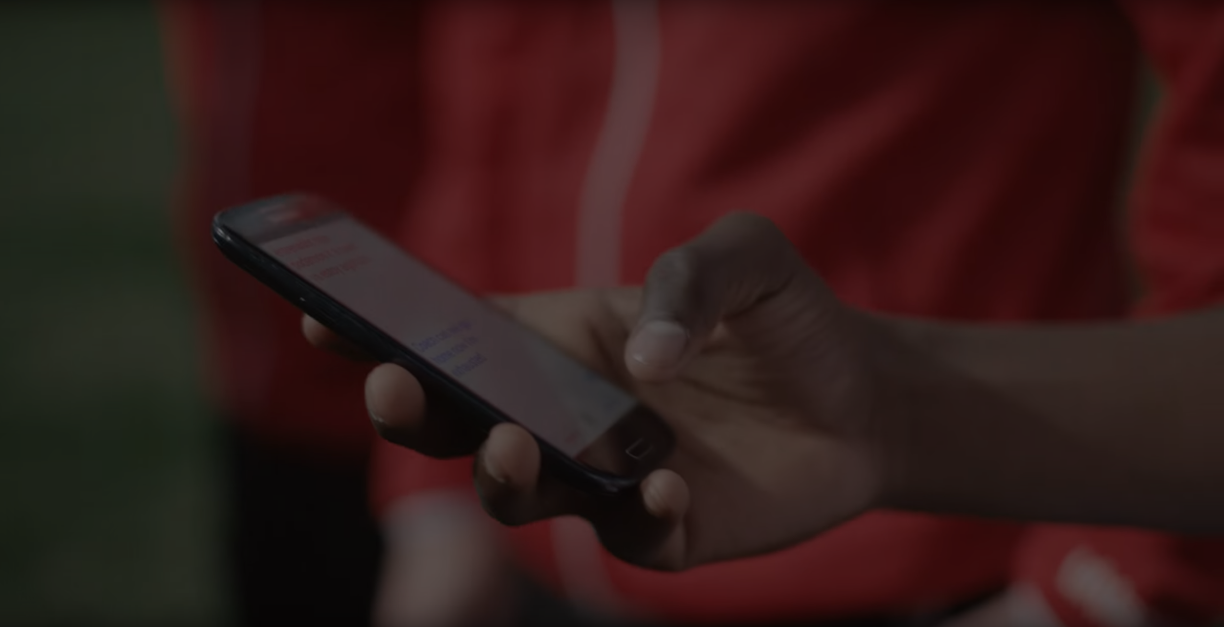
Live Demo

Slide 12
Thank you

